Slide 1
Analysis:
The “why” and the “how to”

Slide 2
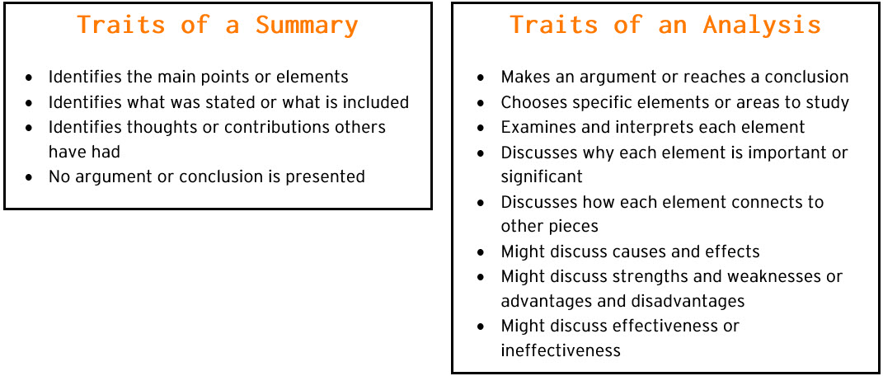

Slide 3
Why we analyze
Analysis is a process we undertake to better understand a piece of writing, an image, film or other media.
The process involves identification of and focus on specific elements.
These elements help us draw conclusions about ideas, themes or patterns.
The conclusions we make about various elements help us to understand the message or theme of the media in question.

Slide 4
How to:
We will start by using images to help us understand the process of analysis.
Our goal will be to explain not only what message or theme the picture is trying to deliver but also how it delivers this message or theme.

Slide 5

Here are some elements we might consider in the “Hope” image
Color scheme
The word “Hope” (capital letters)
Angle of his gaze
Brand/Symbol
Facial Expression
Race
What do all of these elements combine to tell us in this image?

Slide 6
Now, let’s try a few images together and see what we can come up with…
Remember: Be as specific as possible when identifying elements of the images
Try to imagine/articulate how each of the elements is working together to create meaning for us
Be specific in stating your conclusions about the image: What is the image about? Who is its intended audience? How does it create meaning for that audience?

Slide 7
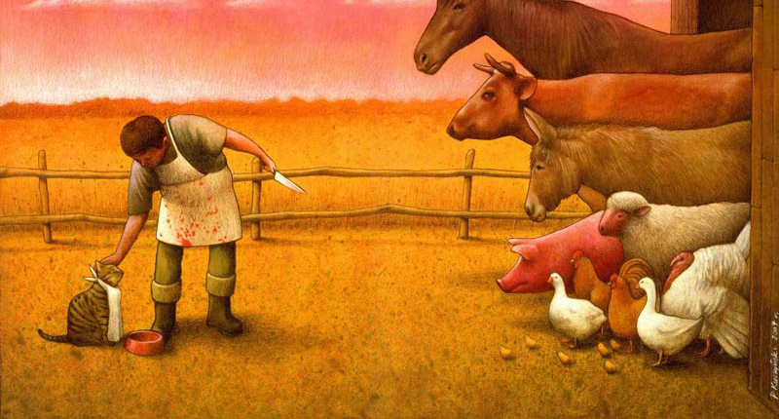

Slide 8
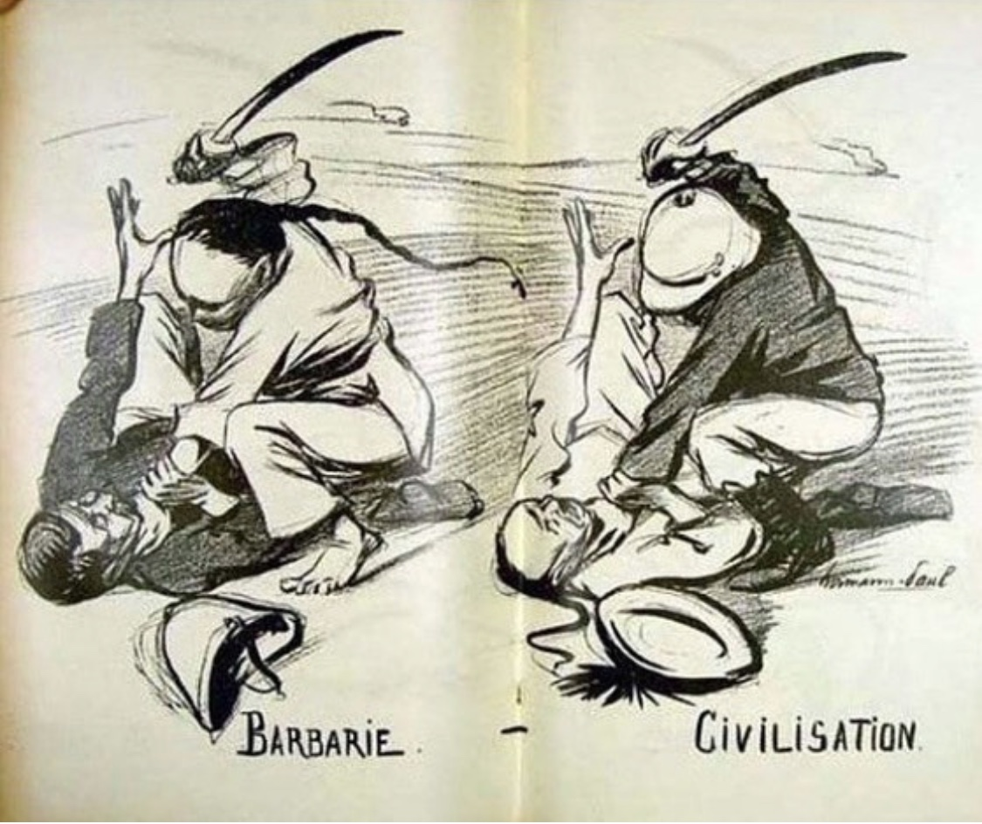

Slide 9
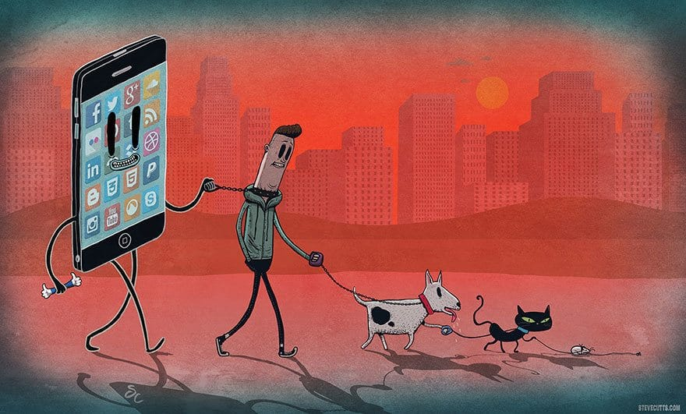

Slide 10
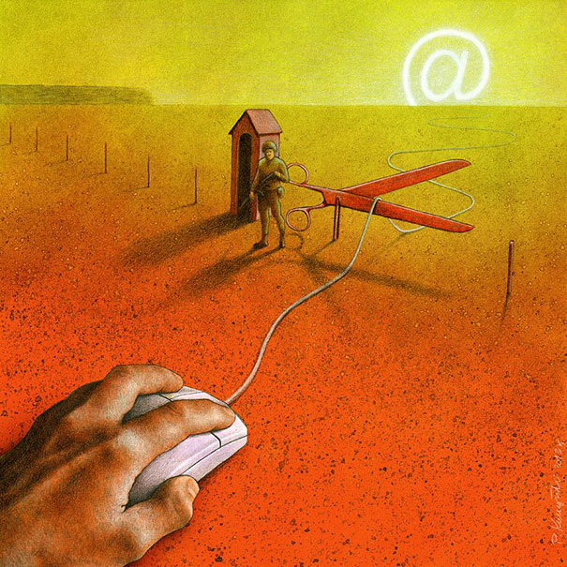

Slide 11
